Slide 1

CSE 423
Virtualization and Cloud Computing
Lecture 13
Module IV
Dr. Madhavi Dhingra

Slide 2
Contents
Cloud Content Delivery Network Services
Multi-CDN
Features of Meta CDN

Slide 3
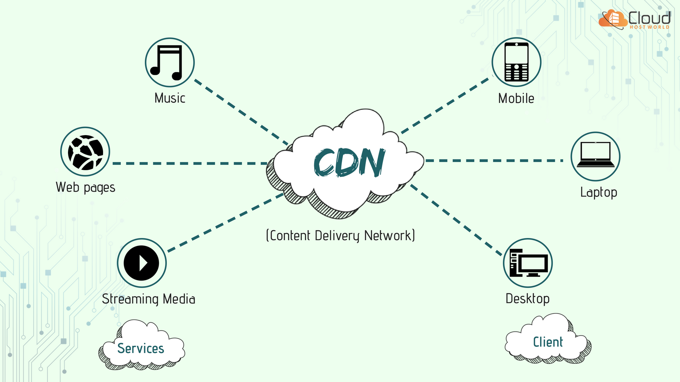

Slide 4
Content Delivery Network
A content delivery network (CDN) is a geographically dispersed network of servers and data centers. The goal of CDN is to facilitate increased web performance and high availability by locating web content copies closer to the end-users.
CDN servers are often referred to as "edge servers" since all CDN servers are located on the "edge network" — closer to end-users than a host server from which an application or a website originates.
CDN servers store or cache copies of various web content subsets from a host server, such as applications, video, audio, images, and HTML files. The content delivery network, by bringing web content nearer to end-users, allows website publishers to control bandwidth consumption, reduce load times, and provide enhanced performance.
Content delivery networks currently serve over 50 percent of the world's web traffic. The percentage keeps rising as more and more enterprises expand their reach to newer markets and offer more diverse types of content. Companies typically purchase content delivery network services from content delivery network providers, who manage and maintain their network of servers.

Slide 5
How CDN Work?
For instance, you have a website on a server based in Australia. Now, if an end-user accesses your website from France, the content delivery network will serve the user from a France-based edge server - closest to the end-user - instead of serving the request from the origin server in Australia. This improves application performance, ensures fast content loading, and also boosts the user experience.
In addition to minimizing the gap between end-users and web content, the content delivery network distributes the traffic load as well, so that traffic requests do not overwhelm a single server.

Slide 6
How CDN Work? Another Example…
CDN works by helping a web publisher deliver faster, higher-quality performance for users through content distribution from servers that are closer to them than the website’s origin server.
For example, suppose your website is based in the United Kingdom (UK). If someone from the United States (US) accesses your site, the CDN serves that user from an edge server in the US, closer to the user, instead of from your UK-based origin server for the web page. The result is faster content loading and web application performance, as well as improved user experience.
More than half of all web traffic is served over content delivery networks, and that percentage continues to grow as businesses expand their global reach and offer more varied content types. CDNs also distribute traffic loads so that no single server is overloaded with traffic requests. Gaming companies, cloud application creators, live-streaming on-demand media and other media services, e-commerce sites with a global reach—as digital consumption needs grow, content owners rely on CDNs to better serve their users.

Slide 7
Advantages
Improved Scalability and Connectivity:
In addition to facilitating end-users with faster load times, which translates into greater user experience, a content delivery network also rewards web publishers with increased traffic, higher page views, lower site abandonment, and stronger customer engagement.
Decreased Bandwidth Consumption:
Web hosting companies charge businesses for any data they transfer from origin servers. A content delivery network, by storing web content copies closer to end-users, ensures less data transfer from origin servers, thereby reducing enterprise costs and bandwidth consumption.
Lower Latency:
Typically, an end-user requests for data and the system transfers it in response. Latency is the lag between the request and the response, which increases as the distance between end-users and servers widens. Since CDN servers are on "network edge" - nearer to end-users - they reduce the latency, optimizing performance.

Slide 8
Advantages
Effective Traffic Spike Management:
Viral videos, limited-time offers, or successful marketing campaigns can trigger a sharp and unanticipated spike in the demand for content. Leveraging load balancing for the distribution of demand across web servers, the content delivery network prevents traffic spikes from affecting website performance.
Enhanced Cybersecurity:
A content delivery network employs automation and data analytics tools that help identify firewall issues, MITM (Man in the Middle) threats, and DDoS (Distributed Denial of Service) attacks.
Amplifies User Satisfaction:
Media playback issues, unresponsive applications, and slow load times are the primary reasons that make end-users avoid/abandon particular websites. A content delivery network minimizes performance issues, which boosts user satisfaction.
Accelerated eCommerce:
A content delivery network facilitates quicker payment approvals, faster product page loading, and seamless transactions on mobile and desktop devices, enhancing the shopping experience. CDN also enables B2B and B2C eCommerce retailers to deliver applications and content speedily, even during times of high traffic.

Slide 9
CDN Services
A CDN primarily offers improved web content delivery, but CDN providers offer additional services that complement serving up content.
Security services
CDNs can provide DDOS protection to data centers and websites.
In a DDoS attack, the attackers try to overwhelm a domain's DNS servers with more traffic than the can manage, with the objective of disrupting or degrading service. CDNs use analytics and automation to monitor for these attacks and respond by limiting request rates (the number of information requests an HTTP can make in a specified time period).
In an man in the middle (MITM) attack, the attacker tries to intercept or alter the communication between the origin server, CDN servers and website users. MITM attacks can occur at a number of places in a network, but CDNs help mitigate MITM attacks by adopting Secure Sockets Layer (SSL) and Transport Layer Security (TLS) protocols to secure communications between the CDN and the website origin server, as well as between the CDN and the ISP.

Slide 10
CDN Services
Private CDNs
If you work with a content delivery network, you'll most likely share network functionality with other CDN customers. However, some CDNs now offer private CDNs, which provide the customer with their own dedicated CDN resources. A private CDN might appeal to an organization that has strict security needs or specific geographic requirements, or that simply wants its own dedicated edge servers that are highly available and won't suffer any latency issues.
Analytics
Content delivery networks may offer real-time analytics for monitoring website traffic and gathering metrics about visitors to a site. The objective is to track user behavior. With that information, website and web application creators can optimize content for users, improve site service and target marketing efforts to specific user personas.

Slide 11
Multi CDN
The need for a multi-CDN strategy arises when an organization’s traffic load increases beyond their current capacity limitations on one CDN provider or if they are looking to distribute their content geographically across providers strategically.
This is because of the many advantages to hosting content from different CDN providers – geographical redundancy, security, increased performance, and cost savings (multi-CDN can help reduce bandwidth costs by balancing out loads) and taking advantage of the pricing differences between different CDN vendors for different situations, time-slots, etc.
First off, let’s take a quick look at what a multi-CDN architecture is and then dive into the implementation strategies.

Slide 12
What is a Multi-CDN Architecture?
In a multi-CDN architecture, a website/streaming service’s content (images, video files, etc.) is cached across multiple CDN providers in different geographic regions.
With the help of intelligent load balancing algorithms and data collected at different points of the delivery pipeline, the incoming traffic from the video players (clients) is distributed across these multiple CDN providers, which provides greater redundancy and performance benefits.
Data is generally collected via QoE/QoS analytics providers with code running on every single video player that a service uses or from proprietary ways of measuring network performance (time taken to download a dummy file, e.g.).
All of this data is used by a central rules engine or server to decide which of the multiple CDNs should serve the requests arising from a certain region.

Slide 13
Multi CDN Features …
The MetaCDN Multi CDN combines a range of existing CDN providers into one large global network. The MetaCDN technology dynamically optimizes and unifies leading cloud and network infrastructure providers across the globe to rapidly, securely and reliably accelerate web content to users wherever they are in the world.
By combining multiple CDN providers into one network, you get access to their aggregate power and reach, with the peace of mind of automatic failover to redundant networks in each region.
Multi CDN Features :
- CDNs are selected based on what will be fastest for the individual user. If there are multiple providers in one region, we will serve content from the fastest one.
- If a CDN providers network goes down, we will route traffic through another provider. This means we can guarantee a 100% service uptime.
- You get access to a huge amount of CDN locations, which wouldn’t have been possible with one provider.
- CDN data centres can handle many more requests than a single server. This helps to relieve the load on your main server.

Slide 14
Pros
Avoid a single point of failure: Using multiple content delivery networks can ensure 100% availability. In the case of a content delivery network outage, the current CDN can be replaced with another CDN.
Performance benefits: Multiple CDNs means more servers and reduced latency. Lower latency and faster loading times mean less lagging and buffering. The result is a higher-quality broadcast for both live streaming and video on demand. You can get away with high latency when a few seconds don’t make much of a difference, like when downloading a book, but these few seconds make a huge difference when live streaming.
Enhanced security: A common type of cyber attack is called DDoS, where basically bad actors try to overload a server or network to cause it to fail. Think of a traffic jam. In a setup with multiple CDN providers, if the servers from one CDN gets attacked, traffic can just be rerouted and “fall over” to the servers of another CDN.
Lower bandwidth costs: Different CDN providers offer cheaper rates in certain regions. When setting up a multi-CDN strategy, you can route to the cheaper option.
Scalability: With multiple CDNs, you can better handle traffic spikes or virality. By using a multi CDN service, there are more servers to distribute the load and to handle requests, so the chance that any one server will be overloaded and fail is practically nonexistent.
Reach remote areas: Generally, the closer a user is to a server, the lower the latency. Although data moves very fast today, it can’t travel faster than the speed of light. For that reason, distance will likely always play a role in video performance. Having strategic multiple CDN providers gives you more distributed edge servers, making it possible to deliver high-quality video experiences to more remote areas.

Slide 15
Cons
Cons:
Need to pay extra attention to configurations: You need to ensure configurations are the same across all CDN providers. For example, in reference to simple multi-CDN load balancing, you want to make sure that if you blacklist European traffic on one CDN, you also blacklist it on others.
Measuring performance may take longer: With multi CDN providers comes multiple capture logs to sort through to measure performance.
Integration and training costs: Unless you have the technical knowledge to integrate a multi CDN strategy, you may have to hire experts or invest in a multi-CDN service solution that can help you manage multiple CDNs.
More strategic thinking required: Choosing how to allocate specific workloads and determining which content delivery network will serve which user or session based on whichever rules requires some technical know-how.

Slide 16
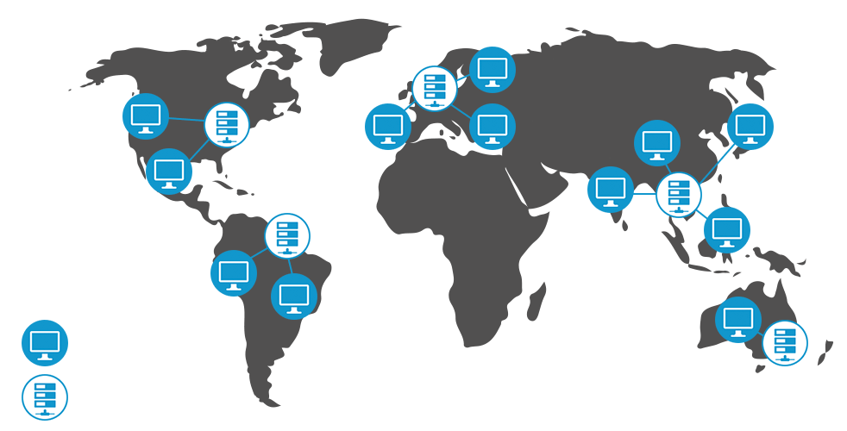

Slide 17
